Slide 1
Advanced topics in geographic analysis
Dr Kristin stock

Slide 2
overview
Geographic data analysis using social media data
Machine learning with natural language descriptions of location
Other tools for working with geographic data

Slide 3
Example project: landscape aesthetics using flickr data
Goals:
  To map the attractiveness of the New Zealand landscape
  To determine whether frequency of Flickr photos is a good indicator of landscape attractiveness
Remember indicators?

Slide 4
Collecting flickr data
Using python script to collect image data by Flickr API (Application Program Interface) method:
  with tags from a list of geographic features
  only photos that were geotagged
Extracted tags, descriptions, photo and location
Many photos of food, weddings, people’s houses
Filtered out indoor photos using machine learning classification
  Flickr API has indoor/outdoor attribute, but only about 5% had the attribute populated, most unknown
  Used tags from those that were marked as indoor/outdoor

Slide 5
Filtering data
Classification and filtering of dataset into indoor & outdoor images using Weka
Training set from those with an attribute value
Created model of types of tags that appeared with indoor vs outdoor images
Classified those without attribute value by learning from those with value

Slide 6
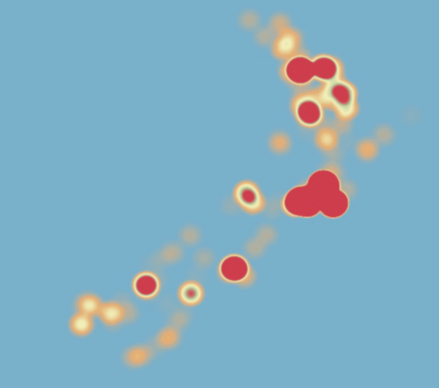
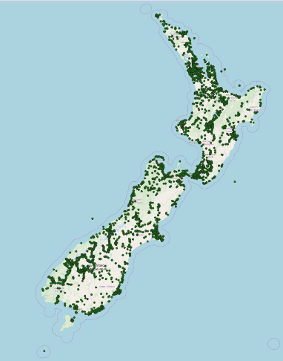
Images map and Heatmap

Slide 7
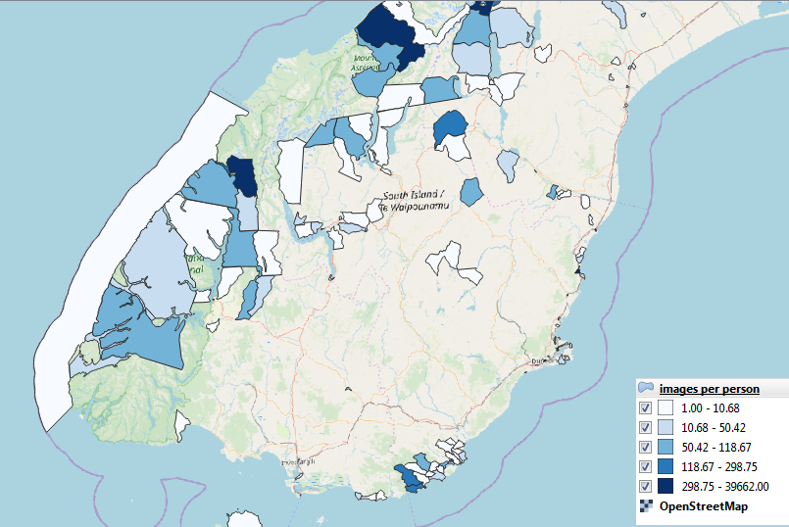
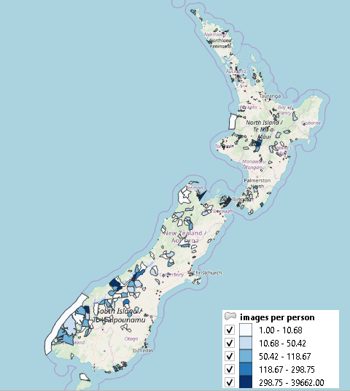
Images per person by meshblock

Slide 8
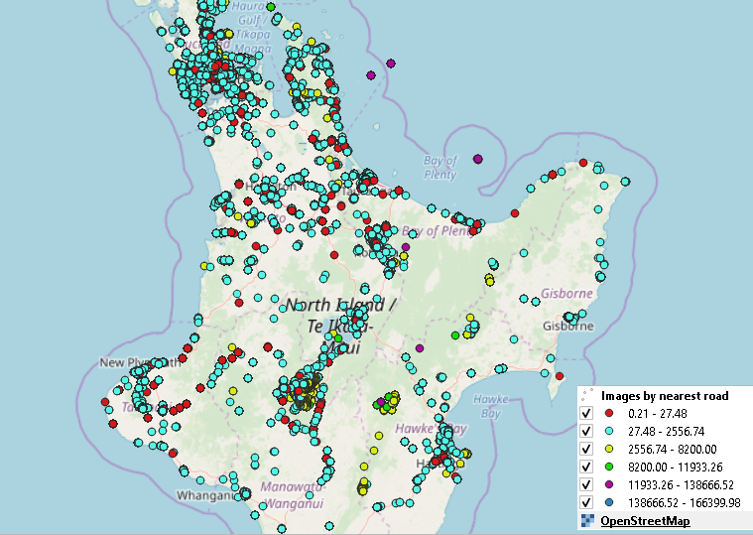
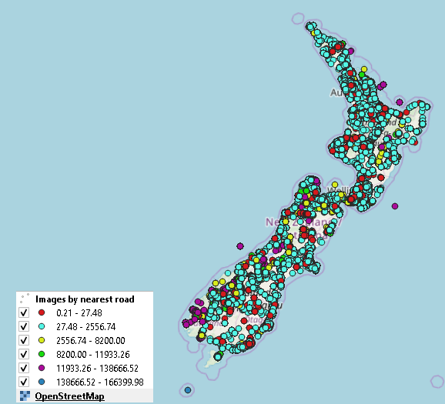
Images By distance to nearest road

Slide 9
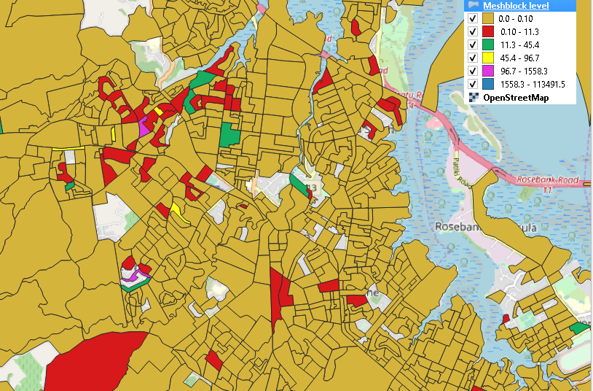
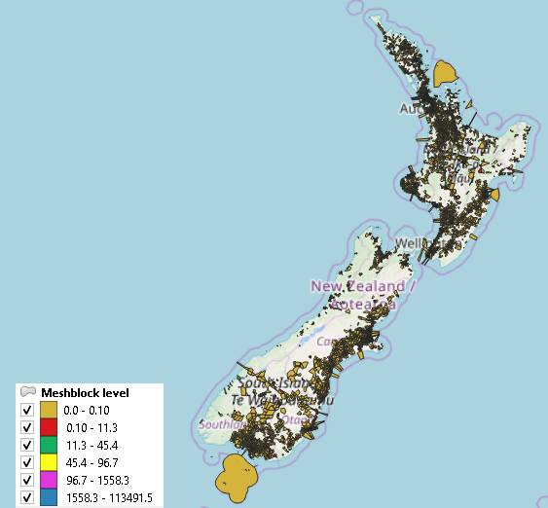
Meshblock level map
(Images count *distance)/ (population *area)

Slide 10
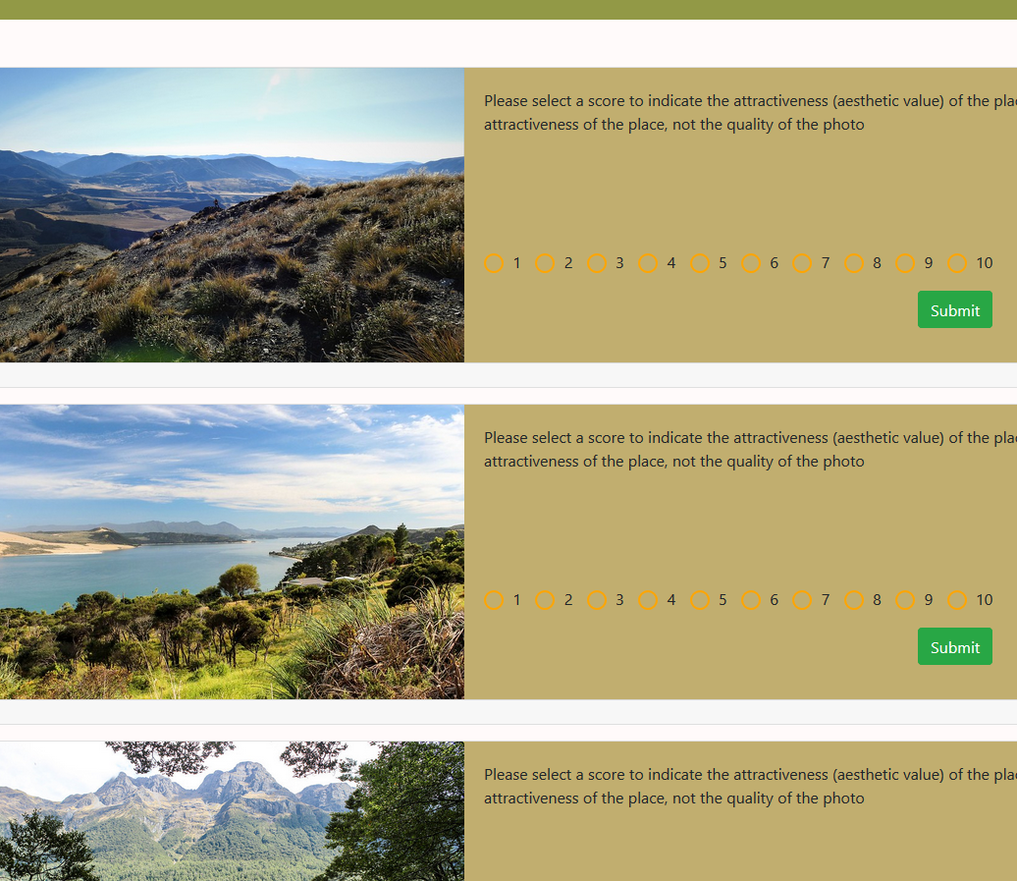
Testing the effectiveness of the method
We tested against data collected through a crowd sourcing web site
http://scenicnz.massey.ac.nz/
Randomly selected photos from the data set extracted from Flickr
Collected people’s views of the attractiveness

Slide 11
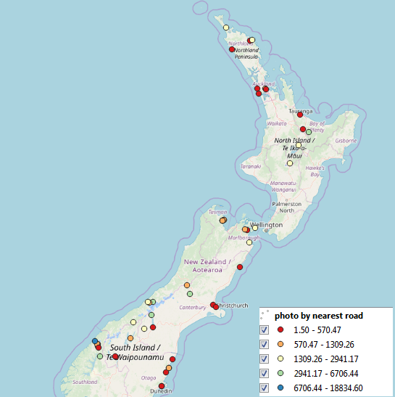
Testing the effectiveness of the method
Tested the correlation between average attractiveness score and photo density for 50 random photos
Also tested correlation with adjustment for population, area, distance
Did not find any statistically significant correlation
More research needed to validate, look for other variables

Slide 12
Machine learning to georeference natural language descriptions of location
Goal: to find the coordinate location (georeference) for expressions like:
  the house beside St Andrews Church
  the flower shop opposite the town square
  the church near the bridge across the Waikato River
  a village just outside Hamilton
These expressions all rely on spatial relations (beside, opposite, near, outside), which are usually prepositions (but not always)
The meaning of these can vary by context

Slide 13
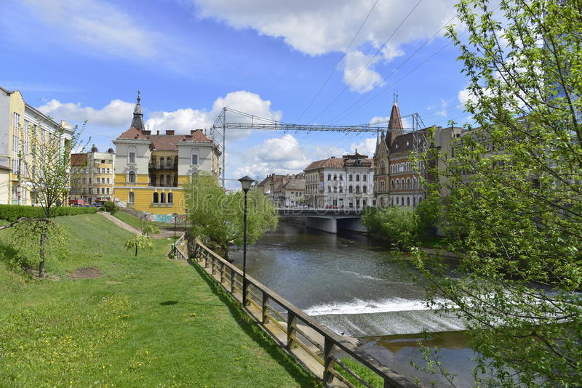
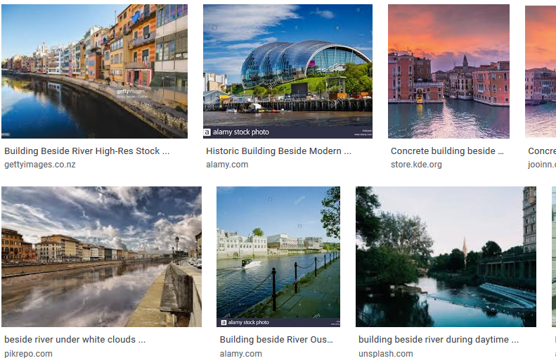
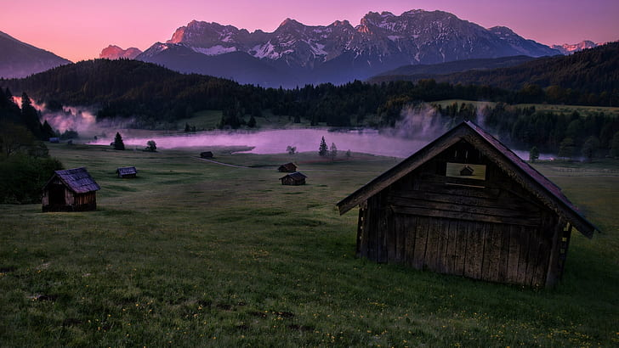
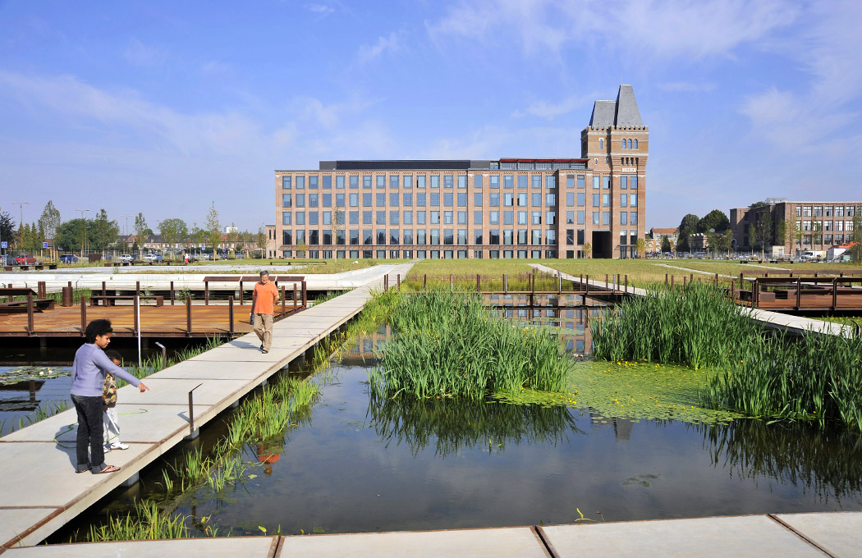
“building beside river”

Slide 14
There are many variables that might influence how a preposition is interpreted
Feature types
Scale
Geometry type
Land use
Density of features
Proximity to other features
Presence of other similar features in between
Shape
Structure (axis)
Static/movement
Indoor/outdoor
Reason for utterance
Gestures

Slide 15
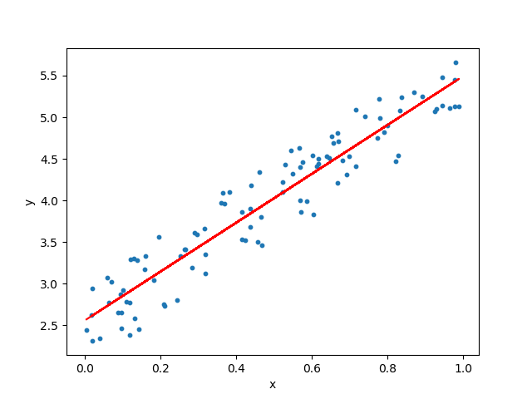
Machine learning
We are building a machine learning model that will use many of these features as inputs, and use regression to try to predict offset of referenced object from reference object
We add to our model many examples of expressions that are already georeferenced, and the input features for all of those expressions, and the model makes its best prediction
Using expressions in central London, UK
Results pending!

Slide 16
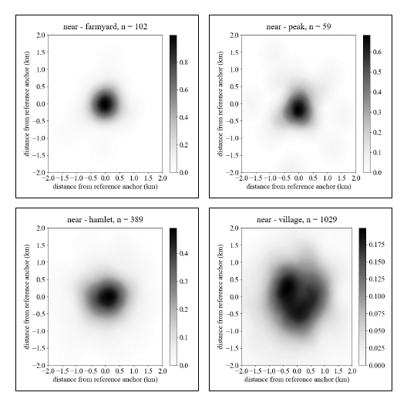
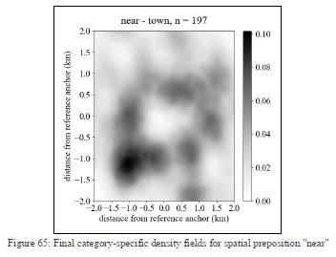
Surface modelling geospatial prepositions
We can then build surface models for specific spatial relation words or expressions that indicate the probability that different locations are likely to be correct
Source: Conner Morris, Cardiff University

Slide 17
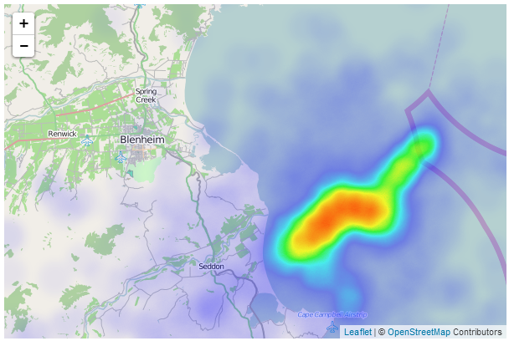
Kernel density estimation (KDE) (1)
Used to make heatmaps
A smoothing function, has some similarities to the ideas that we discussed in spatial interpolation in that it generates a smoothed surface
But, KDE creates the smoothing function using density of points, not z values
KDE models point density, while the spatial interpolation methods we talked about model some other variable that is measured at sample points
Source: http://www.d3noob.org/2014/02/generate-heatmap-with-leafletheat-and.html

Slide 18
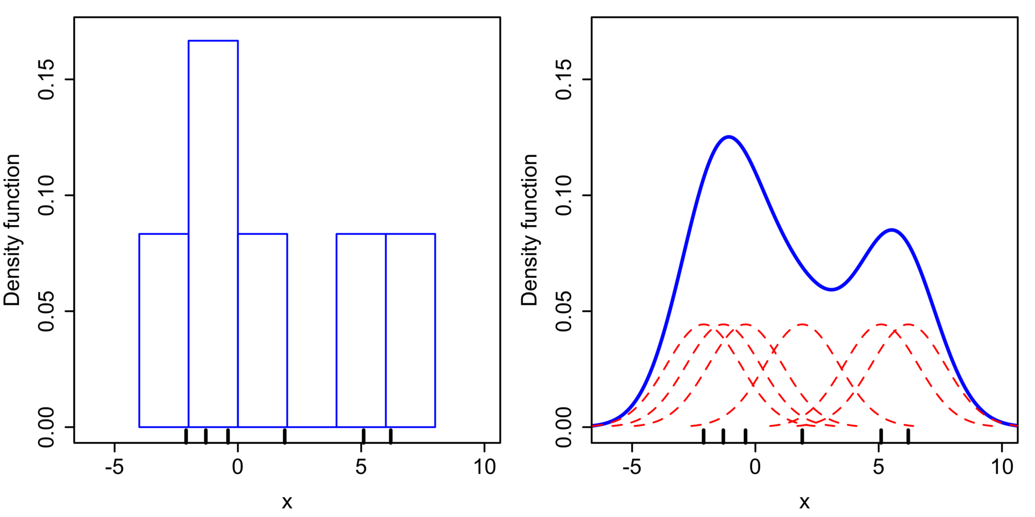

Kernel density estimation (KDE) (2)
Smooths out the data, based on frequency
Similar to histogram, but with a smoothing function using some kernel
There are many different types of kernel: uniform, triangular, biweight, triweight, Epanechnikov, normal
We select a value for the bandwidth parameter that influences the surface
e.g. We place a normal kernel with standard deviation 2.25 (indicated by the red dashed lines) on each of the data points x_{i}. The kernels are summed to make the kernel density estimate (solid blue curve).
K = kernel function, h = bandwidth (smoothing parameter)
Source: https://en.wikipedia.org/wiki/Kernel_density_estimation

Slide 19
Other tools for working with geographic data
We have talked mainly about GIS, and GIS is a very powerful tool for geographic data analysis and visualisation
Sometimes you want to integrate geographic analysis with other tools
There are many libraries to enable this, for different languages and environments
Also, most GIS packages provide libraries of their objects and methods (e.g. QGIS objects can be imported into Python)

Slide 20

python
Currently one of the most popular choices for programming with geographic data
Many options for importing geospatial functionality:
  QGIS (PyQGIS) and ArcGIS (ArcPy) both offer libraries that can be used with Python
  GDAL/OGR/Fiona:
    Based on OGC Standards, widely used
    Especially powerful for raster/remote sensing
  GEOS: Computational geometry
  Shapely: Geometry analysis and manipulation, and computational geometry (e.g. find closest points)
  Geopandas: vector data, handles many formats
  Others to look up: Rasterio, pyproj, pyshp, geotext
KDE with Python

Slide 21
javascript
Some popular libraries for geographic data analysis and visualisation are:
  Turf.js: spatial operations, analysis, geoprocessing, working with GeoJSON, statistics
  Mapbox.js
  D3: especially for visualisation, including styling of maps
  Cesium: 2D and 3D visualisations
  Node.js
  CartoDB.js
  Three.js: 3D visualisations
  Leaflet, OpenLayers for creating web and mobile maps

Slide 22


geotools
Java library
Open source
OGC standards compliant – implements many of the OGC standards
Full range of functionality for GIS

Slide 23
R and spatial analysis
Software environment and language for statistical computing and graphics
Has been used for many years to do advanced statistical analysis for scientific purposes
Also implements OGC standards
See https://rspatial.org
You can do many of the things we’ve talked about: spatial autocorrelation, kriging, map overlay
Good for advanced spatial statistics, but visualisation less convenient than with GIS – but you can programme more advanced visualisations for reports etc.

Slide 24
d3
D3 = Data Driven Documents
Libraries for javascript that specialise in visualisation
If you want to make advanced types of geovisualisation products that can’t be done through GIS, D3 is a good option
Uses SVG and GeoJSON
Many examples here: https://bost.ocks.org/mike/example/
https://www.ctps.org/dv/lrtp_dashboard/index.php

Slide 25
summary
There are many other things you can do with geographic data:
  Social media
  Machine learning
There are many other tools you can use to work with geographic data, integrated into other language and environments
Many overlaps/extensions/piggy backing among the libraries

