Slide 1
Network analysis, gravity modelling, location-allocation
Kristin Stock

Slide 2
outline
Allocation of locations to their best centre
All the locations that are within a specified distance of a specific centre and that total some measure of demand
Network analysis
Routing Problems
Network allocation
Spatial interaction modelling
gravity models
Location-allocation
All the locations within a specified distance of a specific centre
Paths and distances between individual points

Slide 3
Multi-criteria evaluation involving network modelling
In addition to more static criteria in a multi-criteria evaluation, we often have criteria that depend on network analysis
e.g. site must be
in County X;
within 30 minutes travel time of place Y;
above Z metres in elevation.
There is a general problem in geospatial modelling, in which we try to calculate the cost of routes through networks. Cost may be based on:
Distance
Travel time
Source: Professor Christopher Jones, Cardiff University

Slide 4
Allocation of locations to their best centre
Routing problems
Routing and scheduling involves decisions about the optimum tracks followed by vehicles
The shortest-path problem finds the path through the network between a defined origin and destination that minimizes distance or some other measure based on distance
The traveling-salesman problem (TSP) is to select the best tour out of all possible orderings of places to visit, in order to minimize the distance (or other measure) travelled
The orienteering problem is similar to TSP but the objective is to maximize the rewards associated with visiting a selection of the stops while staying under a maximum distance.
All the locations that are within a specified distance of a specific centre and that total some measure of demand
All the locations within a specified distance of a specific centre
Paths and distances between individual points

Slide 5
Network Routing – shortest path problem
Given a network (road, railway, gas, electricity...):
find least cost route from node A to node B
cost in a road network typically refers to distance or time
Find least cost route from A to B via specified set of other locations (travelling salesman problem)
Links of network must be associated with:
impedance values of distance, time or other factor – what we want to minimise
directional and turning constraints (e.g. one-way street in given direction, no left turn at junction)
What else might be use as impedance value?
We could also build a network routing model that tried to maximize the impedance value (e.g. most scenic landmarks)
5
B
4
6
5
5
5
7
3
6
5
4
5
7
5
6
5
4
5
6
5
5
4
5
A
Source: Professor Christopher Jones, Cardiff University

Slide 6
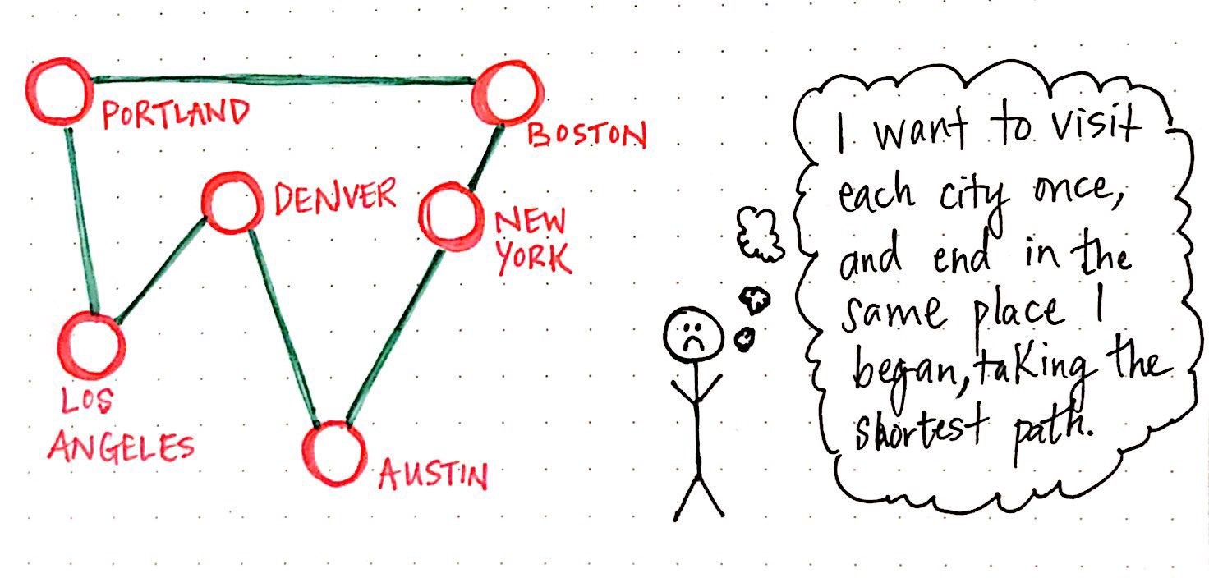
Network Routing – travelling salesman problem
Source: https://medium.com/basecs/the-trials-and-tribulations-of-the-traveling-salesman-56048d6709d

Slide 7
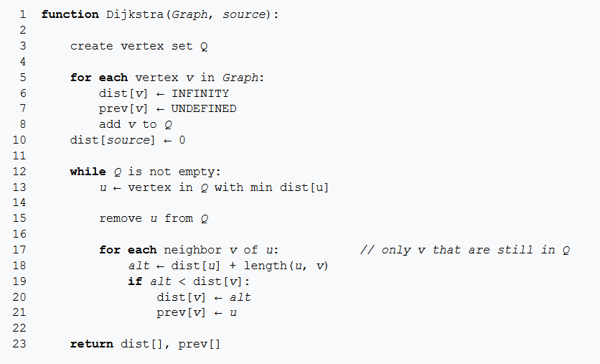
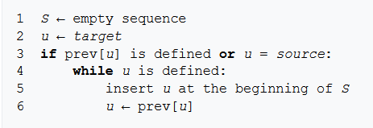
Dijkstra’s algorithm
Calculates the shortest path between two nodes (or to all nodes from a source)
Starts by assigning a distance of infinity to all nodes
Then from the start node:
calculates the distance to every connected node as sum of distance of current node plus distance to each connected node
if it is less than current value of node, reset to calculated distance
To read back the path:
Source: https://en.wikipedia.org/wiki/Dijkstra%27s_algorithm

Slide 8
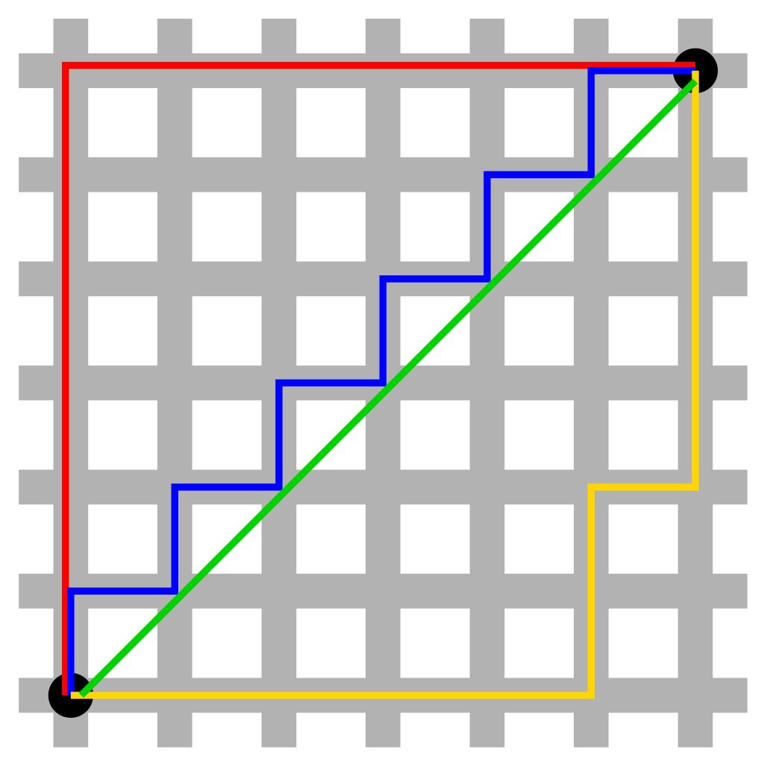
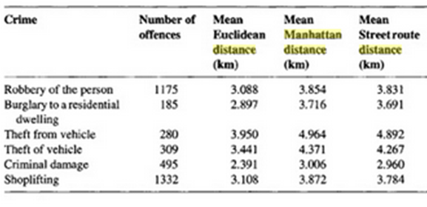
Distance metrics
If we are including a distance metric in a multi-criteria evaluation problem, we might want to include a measure like ‘within x distance’
Applications like:
journey to crime for crime analysis, distance to hospital for health analysis
We can use different distance metrics
Euclidean distance (green):
As the crow flies, distance from one point to the next, doesn’t consider roads or routes
Simple, but often not very reliable because we can’t drive (walk) everywhere
Street-distance:
Accurate, but requires a lot of detail about turns, obstacles etc.
Manhattan distance (red, yellow, blue):
Inspired by city block
Measures distance only in horizontal and vertical directions
And with right angles
Source: https://en.wikipedia.org/wiki/Taxicab_geometry
Source: Chainey, S., & Ratcliffe, J. (2013). GIS and crime mapping. John Wiley & So

Slide 9
Network allocation
Allocation of locations to their best centre
We go beyond looking at the path of an individual person or vehicle, and look at the network behaviour of many people
Once we understand the distances between populations and services, we can allocate areas to different centres.
Example motivations / requirements:
Fire stations and hospitals:
all places served should be accessible within 10 minutes travel time
Schools
school should be within 30 minutes walking distance of the population served;
where are the nearest 500 potential students
Retail applications
Choose a location that has a certain customer catchment within a specific distance
All the locations that are within a specified distance of a specific centre and that total some measure of demand
All the locations within a specified distance of a specific centre
Paths and distances between individual points
Source: Professor Christopher Jones, Cardiff University (adapted)

Slide 10
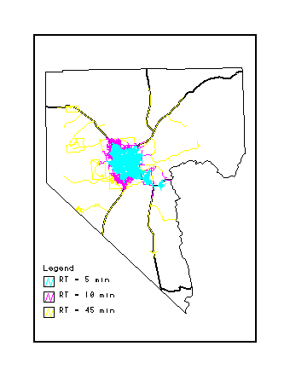
Distance/travel time-based
Each link of road network labelled with its length and type (or grade of road – which affects speed)
( + other data about direction of flow and turn restrictions)
Procedure spreads out from the source location
Identifying links in the network
within specified distance/time
constraints can be applied.
An application of Dijkstra’s algorithm, which builds a table of distances from the source using particular paths, but in this case we can apply weights
Source: Professor Christopher Jones, Cardiff University

Slide 11
Distance and demand-based e.g. 30 minutes walk and 500 children
Allocation of locations to their best centre
Each link in network is labelled with some measure of demand (in addition to distance/time)
e.g. the number of school-age children living there;
The source is associated with some measure of supply
e.g. the number of students that the school can take.
Procedure searches out from the service centre and stops either
when the distance/time limit is exceeded
or when all the supply has been used up.
All the locations that are within a specified distance of a specific centre and that total some measure of demand
All the locations within a specified distance of a specific centre
Paths and distances between individual points
Source: Professor Christopher Jones, Cardiff University

Slide 12
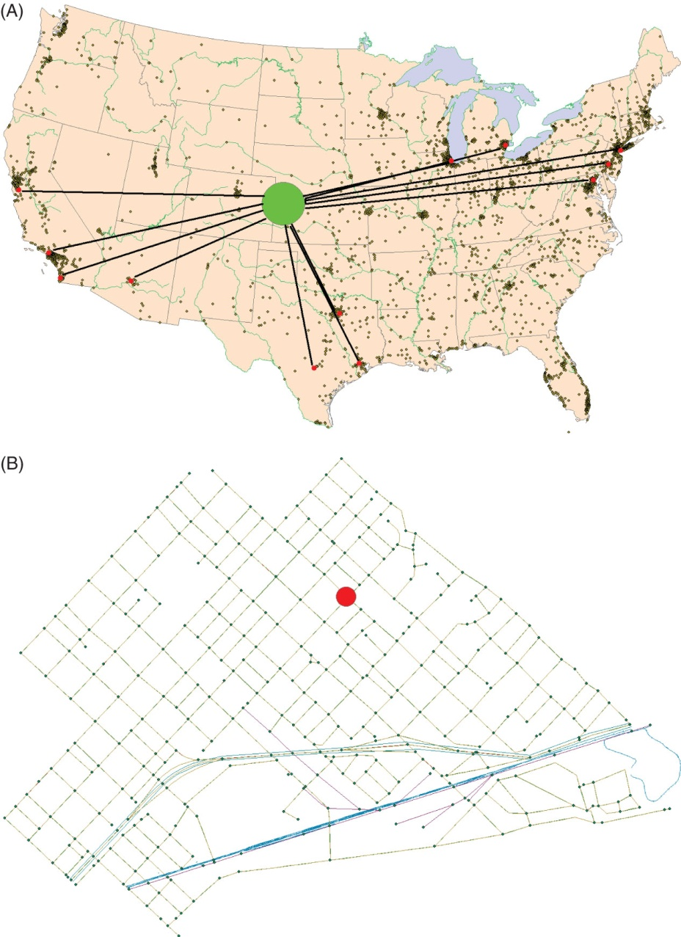
Search for the best locations for a central facility to serve dispersed customers
the problem is solved in continuous space, with straight-line travel, for a warehouse to serve the 12 largest U.S. cities. In continuous space there is an infinite number of possible locations for the site.
a similar problem is solved at the scale of a city neighborhood on a network, where Hakimi’s theorem states that only junctions (nodes) in the network and places where there is weight need to be considered, making the problem much simpler, but where travel must follow the street network.

Slide 13
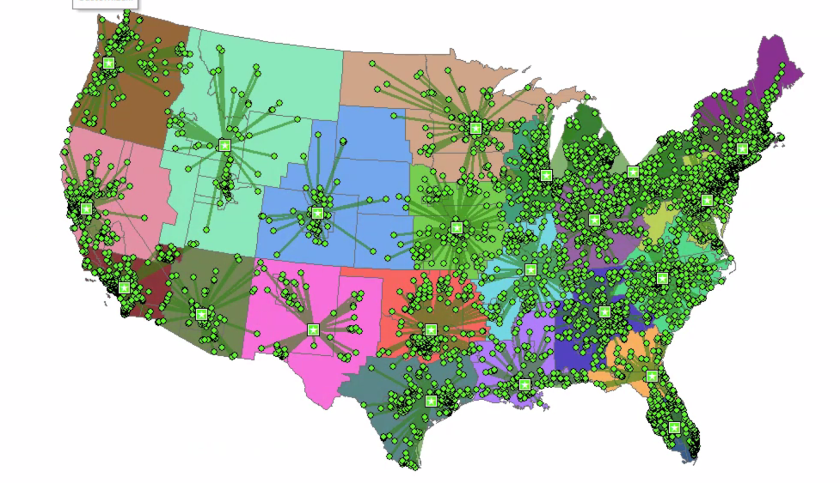
Allocation of locations to their best centre
All the locations that are within a specified distance of a specific centre and that total some measure of demand
All the locations within a specified distance of a specific centre
Paths and distances between individual points
Location-Allocation Network Analysis - Which Distribution Centre Best Serves Each Customer?
Source: http://melissathrush.blogspot.com/2017/10/gis-5935-lab-6-location-allocation.html

Slide 14
Spatial Interaction Modelling (1)
Here we are trying to select the best location for some services, from a number of alternatives
We try to represent and predict the flows of phenomena
such as people, goods and money
between demand locations and supply locations.
Assumes a requirement at demand location, or ‘origin’, for service, or facility, which is provided at the supply location.
Examples of facilities at the supply locations
shop, bank, shopping centre, hospital, factory.
Demand is typically from people living at the origin locations.
usually a spatial zone, e.g. enumeration district, a ward or a town.
Source: Professor Christopher Jones, Cardiff University

Slide 15
Spatial interaction modelling (2)
May need to take into account competing facilities
May have several facilities that are fixed in location, and one that may have variable locations, with the goal of finding one from a set of several alternatives that will maximise profit (in the case of shops)
In a more complex model, we may have several facilities each of which may be in several possible locations

Slide 16
Motivation
Predicting effects of new developments
opening of (or modification to) a shop, shopping centre, health centre, housing estate or factory –
numbers of people that might use it
amount of income that might be generated
Major application: retail site selection for large stores, dealerships - where competition is an issue
other applications: e.g. hospitals, schools, housing developments, factories
Source: Professor Christopher Jones, Cardiff University

Slide 17
Parameters in spatial interaction modelling
Flow from an origin to a destination depends on
‘attractiveness’ of destination relative to other facilities
‘accessibility’ of destination relative to other facilities
Attractiveness
Destinations:
e.g. type of services or goods, range of goods, quality of goods, price of goods, car parking facilities, associated facilities in the case of a shop
For a school or hospital, could be maximum number of pupils, patients, services offered
Origins may be weighted by things like number of residents, disposable income and other socio economic factors, likelihood that they will use the facility
Accessibility
e.g. distance, travel time, cost of the journey
Source: Professor Christopher Jones, Cardiff University

Slide 18
gravity models
The earliest models assumed that the flow between demand and service centres were:
directly proportional to demand and attraction and
inversely proportional to the square of the distance between them
=> gravity models (after Newton’s law of Gravity)
But accessibility found to be a better measure than distance, takes account of:
Mode of transport
Ability and expectation to travel
We use a cost function based on analysis of typical trip lengths in different situations

Slide 19
Gravity models (2)
O1
analogous to Newton’s law of gravitation
Example: gravity model of trade
t_{ij} = a W_{i} W _{j}
c_{ij}²
t_{ij} is the predicted volume of trade from country i to country j
a is a constant
W_{i} is the GDP of country i
W_{j} is the GDP of country j
c _{ij} is the distance between countries i and j
O2
D1
D2
O3
D3
O4
O5
Source: Professor Christopher Jones, Cardiff University

Slide 20
Fill out the distance matrix:
Country | Germany | United Kingdom | France | Italy | Russia | Spain
Germany
UK
France
Italy
Spain
Country | GDP
Germany | 4.16 Tn
United Kingdom | 2.93 Tn
France | 2.88 Tn
Italy | 2.09 Tn
Russia | 1.67 Tn
Spain | 1.50 Tn
Calculate the predicted trade flow between countries:
Country | Germany | United Kingdom | France | Italy | Russia | Spain
Germany
UK
France
Italy
Spain
Which pair of countries has the strongest predicted trade flow?

Slide 21
Gravity models (3)
The equation is too simplistic to be successful in modelling real situations
no value for a to match real data for flows, demands and destinations.
Can be modified in various ways to take account of the need to:
Reflect the differing effects of distance in different circumstances
Meet constraints such as on total demand/attraction, total supply, and total cost
Consider different types of people at origins
Consider different types of product at a facility
Source: Professor Christopher Jones, Cardiff University

Slide 22
An origin-constrained model ( ‘production-constrained’)
Estimate total demand at the origins,
e.g. total amount of money O_{i} spent in each demand zone i on the facilities at the destination
such as from surveys of individual expenditure, geodemographics, census data…
Thus the sum of the flows t_{ij} to all n destinations from the origin i should equal O_{i}:
n
Σ t_{ij} = O_{i}
j=1
Source: Professor Christopher Jones, Cardiff University

Slide 23
origin-constrained model
t_{ij} = A_{i} O_{i}W_{j}c_{ij}ª
A_{i} is a scaling factor that ensures that the production constraint (as defined above) is met, i.e. O_{i} is spread between destinations according to their relative attractiveness
A_{i} = 1 / ∑ W_{j}c_{ij}ª
W_{j} is a measure of the attractiveness of destination j
c_{ij} is a measure of the cost of travel or the distance from i to j
a is a parameter that affects the rate at which cost increases with distance between i and j (e.g. 1/d²)
Source: Professor Christopher Jones, Cardiff University

Slide 24
Additional or alternative constraints
Attraction-constrained model
total flow at each destination known (or approximated)
use model to predict flows from each of the origins
appropriate when facilities have fixed capacities
e.g. factory employing a fixed number of workers
school taking a fixed number of students.
production-attraction constrained model
total flows from origins and to destinations constrained
could study individual flows between each pair of origins and destinations. e.g. in transport modelling
model the flows between a fixed set of employment opportunities and fixed set of residences.
could experiment with varying the cost of transport
(assuming possible modifications to the transport system)
Source: Professor Christopher Jones, Cardiff University

Slide 25
More sophisticated models
Above models are somewhat crude
lump different types of people with different patterns of purchasing behaviour, and different types of product,
not all products are equally attractive to particular types of people.
more effective model needs to be more disaggregated
consider different types of people and products
e.g. population modelling
Source: Professor Christopher Jones, Cardiff University

Slide 26
Birkin et al (1995) propose following model
T_{ij}^{kmn} = A_{i}^{kn} O_{i}^{km} θ _{j}^{mn} W_{j}^{m} exp(-β_{i}^{k}c_{ij})
i a small geographical area (ED, postcode, postal sector..)
j retail outlet destination
k type of person
m type of product
n particular retail organisation
T_{ij}^{kmn} is the flow from i to j, comprising the take up at outlet n at location j of product m by people of type k who come from origin i.
O_{i}^{km} is the demand at i for products of type m from people of type k
W_{j}^{m} is the attractiveness of location j for products of type m
θ _{j}^{mn} is the additional attractiveness for product m of retail outlet n
c_{ij} is the travel time from i to j
-β_{i}^{k} is a distance deterrence factor for a person of type k travelling from i

Slide 27
Model Calibration
We need to obtain some real data to describe the demand and attraction and hence estimate the value for a parameter such as b.
Method of maximum likelihood estimation can be used to fit the model to the data and hence obtain a value for the relevant parameter(s).
https://towardsdatascience.com/a-gentle-introduction-to-maximum-likelihood-estimation-9fbff27ea12f
Source: Professor Christopher Jones, Cardiff University

Slide 28
Calibration Data
Real data on exact sums of money spent is not often available, so need ways to estimate.
Demand
geodemographic classifications of post codes
based on census data, “official” market surveys, questionnaires, direct data such as from store cards or official registration of purchase (cars)
Attraction
Data on particular products at particular shopping centre
from direct observation or Yellow Pages etc
The physical size of outlets selling a specific product.
Commercial data, annual reports, direct observation
The extent to which a particular vendor can attract custom relative to its competitors (independently of the size factor).
company reports of sales
Source: Professor Christopher Jones, Cardiff University

Slide 29
Allocation of locations to their best centre
All the locations that are within a specified distance of a specific centre and that total some measure of demand
All the locations within a specified distance of a specific centre
Paths and distances between individual points
Location-Allocation Network Analysis - Which Distribution Centre Best Serves Each Customer?
Source: http://melissathrush.blogspot.com/2017/10/gis-5935-lab-6-location-allocation.html

Slide 30
Location-Allocation Models
Find optimal location(s) for one or more facilities given a set of candidate locations to choose from
E.g. find sites for hospitals, fire stations or schools that minimise the cost of travel to reach them.
Applicability
Usually assumes that there is no competition (but can be combined with gravity models).
Useful where completely new facilities are to be provided and several options are available, or to analyze existing facilities to determine if ‘optimal’.
Use mathematical optimisation techniques
Often based on network models of space
candidate locations and demand locations are nodes within the network.
use network to determine distances/costs
Source: Professor Christopher Jones, Cardiff University

Slide 31
Location-Allocation (1)
Classic version of problem is p-median problem
Seeks optimum locations for any number p central facilities such that the sum of the distances between each weight and the nearest facility is minimized
Particularly suitable for public facilities (libraries etc.)
Source: Professor Christopher Jones, Cardiff University

Slide 32
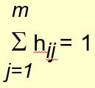
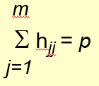
Location-Allocation (2)
There are p facilities to be located, m potential facility locations (index j) and q demand locations (index i)
(i.e. minimise transport costs) ------- Subject to
where h_{ij} = 1 if demand i is allocated to site j, else 0
X_{i} is the demand at location i
c_{ij} is the cost of transport from demand location i to facility j
all nodes are both demand locations and a potential facility location
Find values of h_{ij} that minimize Z (the total cost of transport)
O1
F1
O2
F2
O3
Demand from i met by 1 facility
Total of p facilities allocated
F3
O4
O5
O5
Source: Professor Christopher Jones, Cardiff University

Slide 33
Related types of location-allocation problem
Minimise the maximum distance between origin and destination
→ ‘minimax’ problem
Constrain so all journeys within particular travel time
(relevant to fire service or ambulance service)
→ covering objective
Maximise the number of people that are within a particular distance of each selected facility
→ maximal covering problem.
Introduce capacity constraints:
e.g. total allocation to a facility must not exceed some limit.

Slide 34
summary
Allocation of locations to their best centre
All the locations that are within a specified distance of a specific centre and that total some measure of demand
Network analysis
Routing Problems
Network allocation
Spatial interaction modelling
gravity models
Location-allocation
All the locations within a specified distance of a specific centre
Paths and distances between individual points

