Slide 1
Representing Geographic Data

Slide 2
Outline
Data representation as an abstraction
Raster representation
Vector representation
Geographic Data Modelling
Generalisation
File types

Slide 3
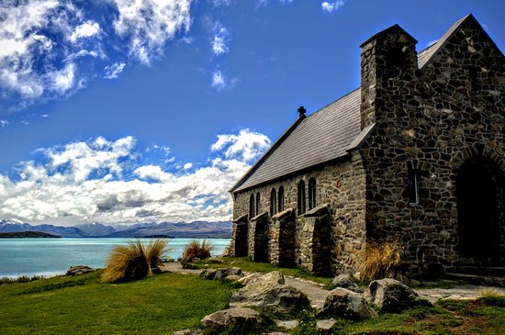
Representing the Real World
We cannot store every detail of the real world in a computer.
We create an abstraction, a representation of the world that is suitable for our purposes.
What would you abstract if you were:
An architect?
A biologist?
A marine scientist?
A geologist?

Slide 4
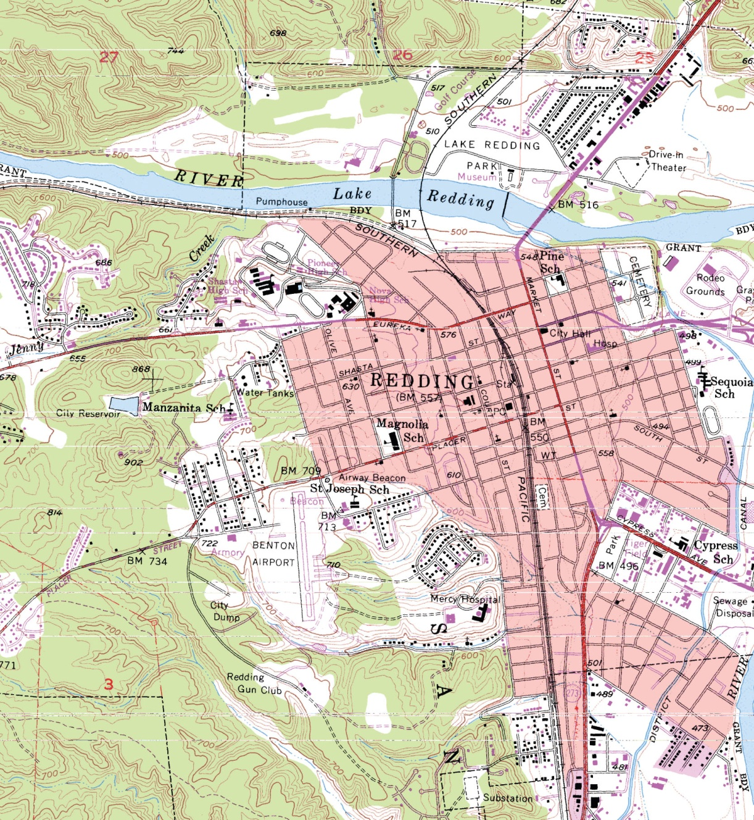
Part of a Digital Raster Graphic,
a scan of a U.S Geological Survey 1:24000 topographic map
(Courtesy USGS)

Slide 5
Levels of Data Model Abstraction
A data model provides
Developers with means to represent an application domain in terms that may be translated into a design and then implemented
Users with a description of the structure of the system, independent of specific items of data or details of the particular application

Slide 6
Examples
Think about the data sets you have worked with in QGIS (roads, land parcels, place names):
How were they abstractions of the real world?
What other kinds of abstractions might have been used?

Slide 7
Two Models for Representing Geographic Data
Discrete objects (aka Vector)
Continuous objects (aka Raster)

Slide 8
Discrete Objects and Continuous Fields
In the discrete object view, the world is empty, except where it is occupied by objects with well-defined boundaries that are instances of generally recognized categories.
Objects can be counted
Objects have dimensionality: 0-dimension (points), 1-dimension (lines), 2-dimensions (areas)

Slide 9
Discrete Objects and Continuous Fields
The continuous field view represents the real world as a finite number of variables, each one defined at every possible position.
Continuous fields can be distinguished by what varies, and how smoothly.

Slide 10
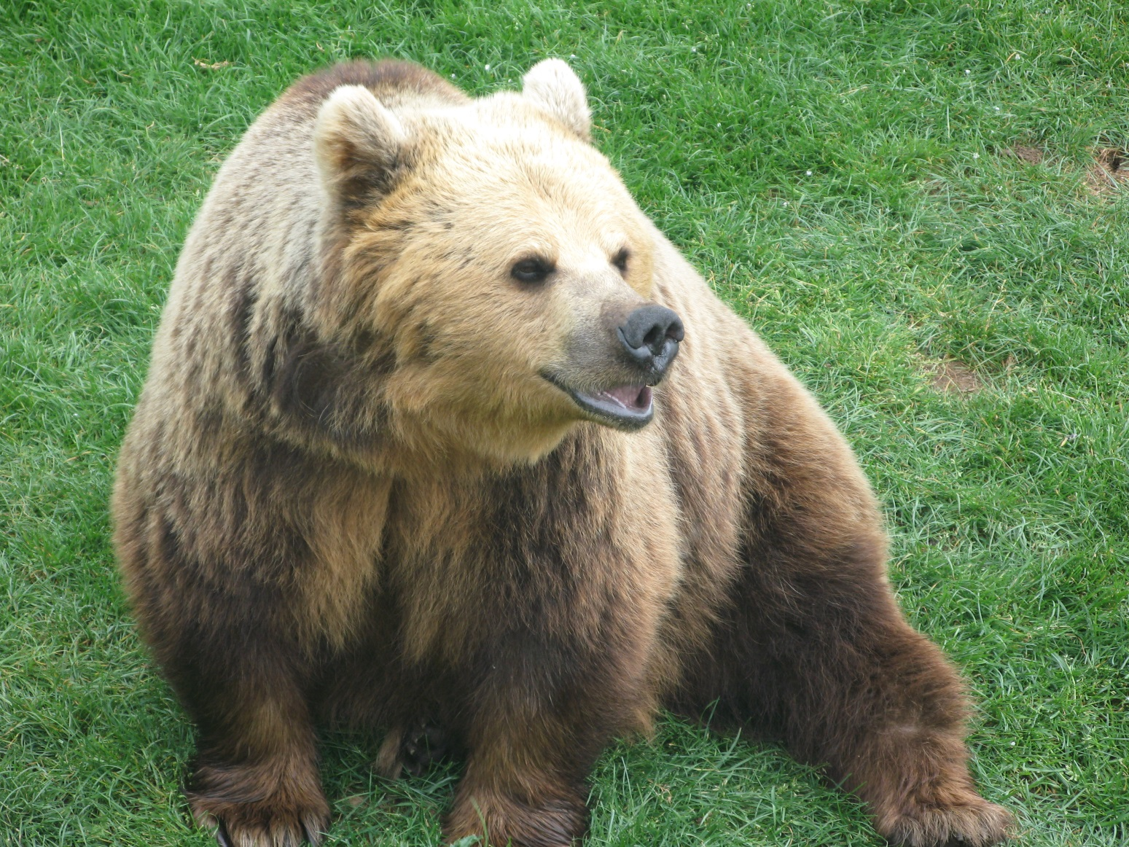
Bears are easily conceived as discrete objects, maintaining their identity as objects through time and surrounded by empty space.

Slide 11
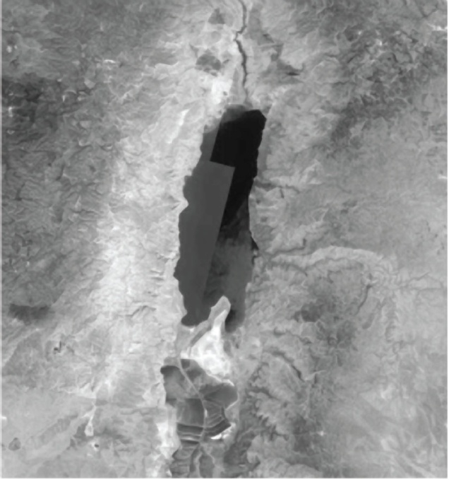
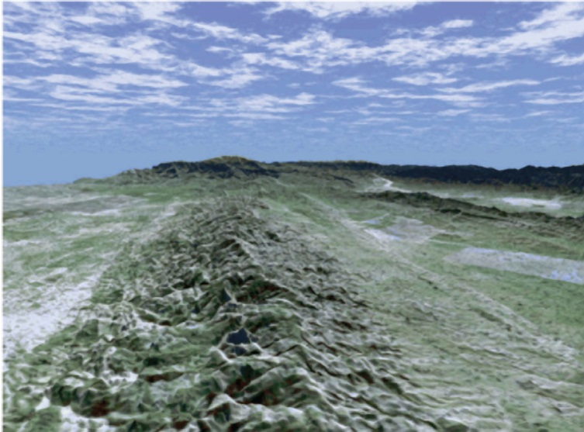
Examples of field-like phenomena
A
(A) Image of part of the Dead Sea in the Middle East. The lightness of the image at any point measures the amount of radiation captured by the satellite’s imaging system.
B
(B) A simulated image derived from the Shuttle Radar Topography Mission. The image shows the Carrizo Plain area of Southern California, with a simulated sky and with land cover obtained from other satellite sources.
(Courtesy NASA/JPL–Caltech)

Slide 12
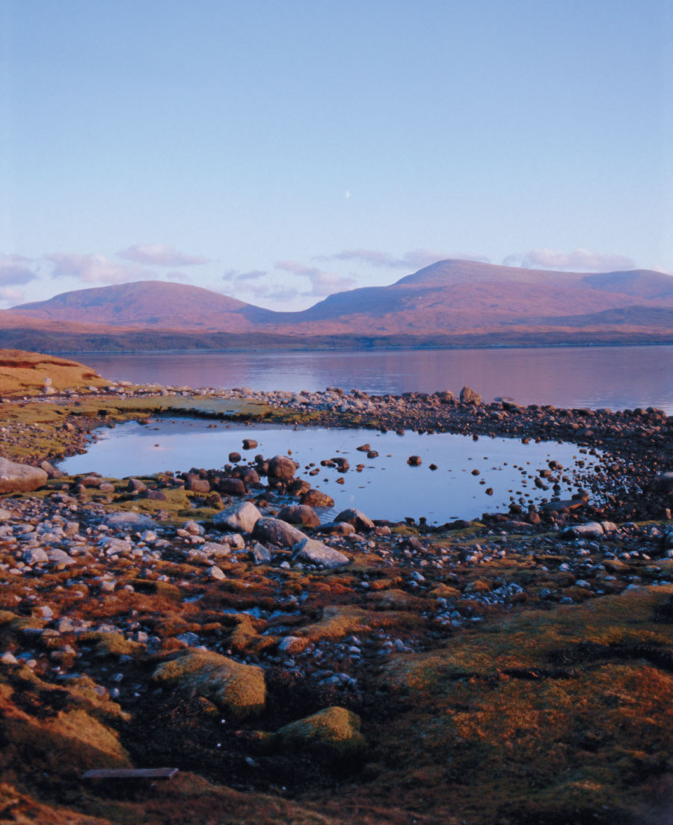
Lakes can be difficult to conceptualize as discrete objects because it is often difficult to tell where a lake begins and ends, or to distinguish a wide river from a lake.
(Oliviero Olivieri/Getty Images, Inc.)

Slide 13
Rasters and Vectors
Two methods that are used to reduce geographic phenomena to forms that can be coded in computer databases
In principle, each can be used to code both fields and discrete objects, but in practice there is a strong association between raster and fields, and between vector and discrete objects.

Slide 14
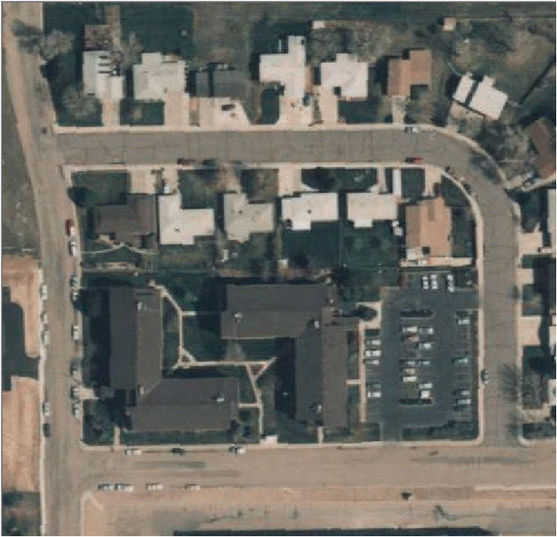
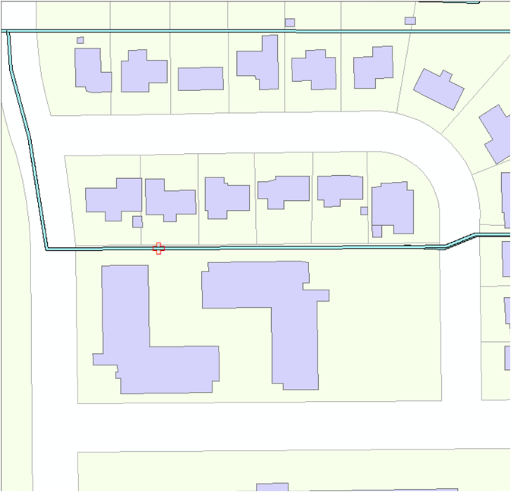
Different representational models of the same area in Colorado, USA

Slide 15
Raster Representations
In a raster representation geographic space is divided into an array of cells, each of which is usually square, but sometimes rectangular.
All geographic variation is then expressed by assigning properties or attributes to these cells.
The cells are sometimes called pixels (short for picture elements).

Slide 16
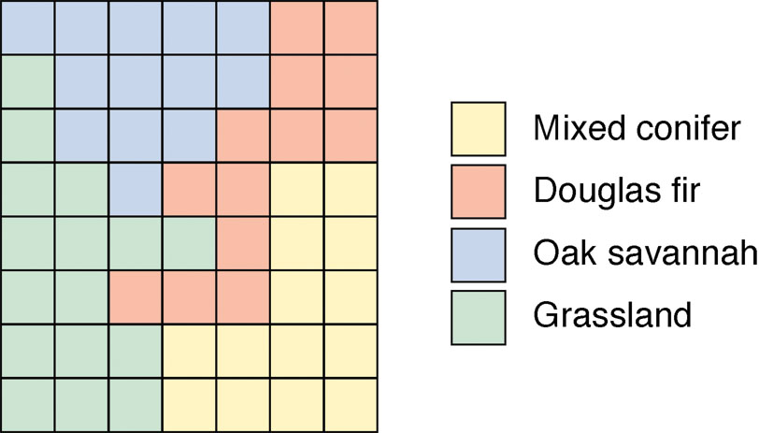
Raster Representation
Each color represents a different value of a nominal-scale variable denoting land-cover class

Slide 17
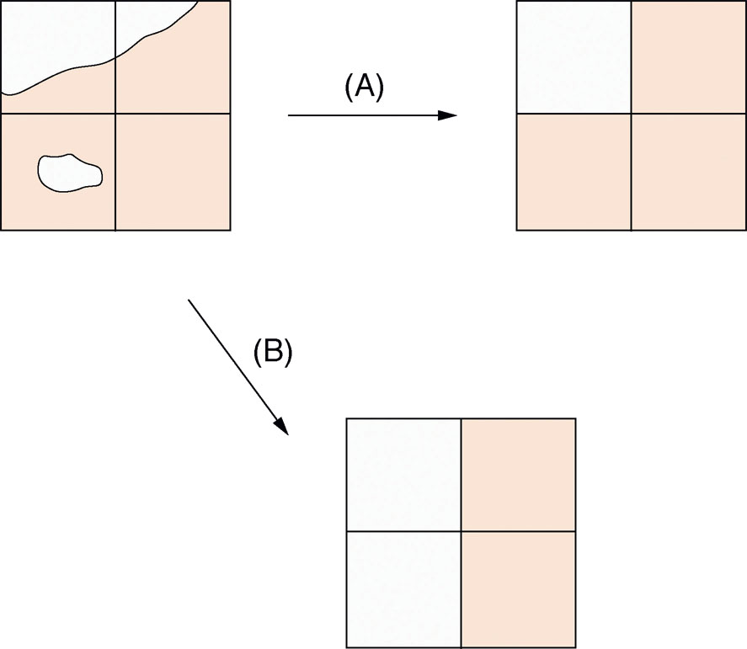
Effect of a raster representation using:
the largest share rule
(B) the central point rule
Adapted from Geographic Information Science And Systems, Longley, Goodchild, Maguire and Rhind

Slide 18
Raster Data Model
Uses an array of cells, or pixels, to represent real-world objects
Cells can hold any attribute values based on one of several encoding schemes including categories, and integer and floating-point numbers
In some systems, multiple attributes can be stored
Techniques for compressing
e.g. run-length encoding, block encoding, and wavelet

Slide 19
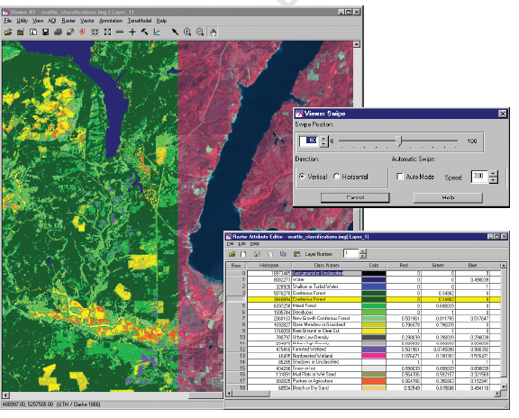
Raster data of the Olympic Peninsula, Washington State, with associated value attribute table. Bands 4,3,2 from Landsat 5 satellite with land cover classification overlaid

Slide 20
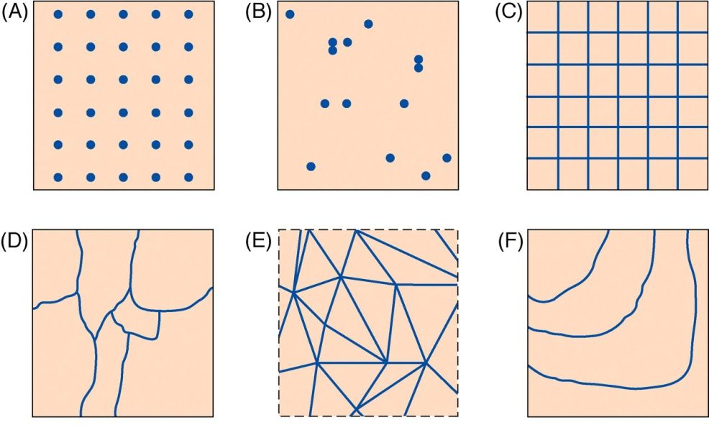
How do we represent continuous variation digitally?
(Courtesy U.S. Geological Survey)
 | Cell type | Example
A | Regularly spaced sample points | 30m elevation DEM
B | Irregularly spaced sample points | temperature at weather stations
C | Rectangular cells | Remotely sensed radiation
D | Irregularly shaped polygons | Vegetation, parcel ownership
E | Irregular network of triangles, with linear variation over each triangle | Elevation in Triangulated Irregular Network (TIN)
F | Polylines representing contours | Elevation contour lines

Slide 21
Part of a Digital Raster Graphic,
a scan of a U.S Geological Survey 1:24000 topographic map
(Courtesy USGS)

Slide 22
Vector Representations
Usually, in a vector representation, all lines are captured as points connected by precisely straight lines (some GI software also allows curves).
Features are captured as a series of points or vertices connected by straight lines
areas are often called polygons
lines are sometimes called polylines
the choice between raster and vector is often complex

Slide 23
Vector Data Model
In the vector data model each object in the real world is first classified into a geometric type
in the 2-D case point, line, or area
Points are recoded as single coordinate pairs
Lines as a series of ordered coordinate pairs
Areas as one or more line segments that close to form a polygon
In some systems, curves can be defined by a mathematical function

Slide 24
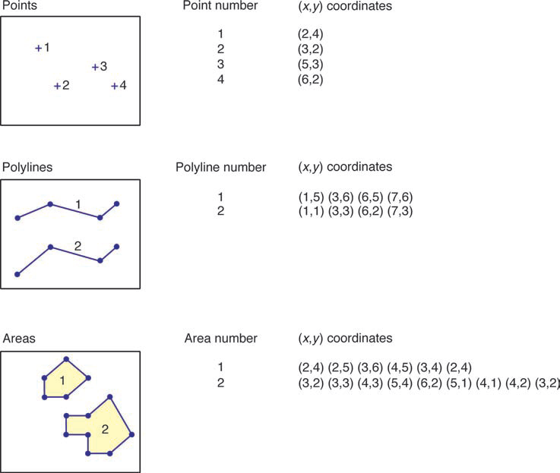
Representation of points, lines, and areas

Slide 25
Geometry Representation
There are many different representations
Some very complex, with topology etc.
Relational models separated elements, avoided duplication.
Object relational models (e.g. Oracle Spatial) encapsulate geometry in an object
We also create spatial indexes for performance

Slide 26
Geographic Data Modelling
We have to decide how we will structure the abstracted data that we see in the real world
Traditional data models have:
Tables
Relationships between tables (foreign key)
Geographic databases have a similar structure
But in GIS we work more with layers.
We need to decide which attributes to store:
Some can be derived from geometry

Slide 27
Layers in QGIS
Example:
OSM Buildings
Place Names
Note:
Geometries don’t appear, unless also stored as attributes

Slide 28
Layers and Data Structures
The layers are simple tables, with attributes and a geometry attached.
Contrast with a normalised database structure
Sometimes how a layer appears is not how the data is actually stored in the database:
Geometry
Views sometimes used to simplify structure

Slide 29
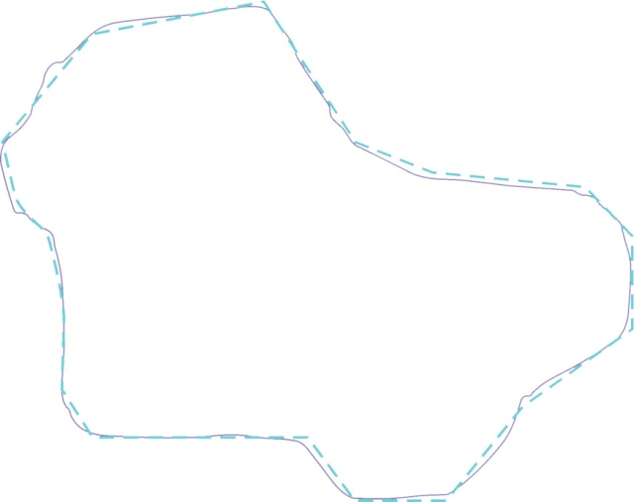
An area (purple line) and its approximation by a polygon (dashed blue line)

Slide 30
Generalization
Ways of simplifying the view of the world include:
describe entire areas, attributing uniform characteristics to them, even when areas are not strictly uniform;
identify features on the ground and describe their characteristics, again assuming them to be uniform;
limit our descriptions to what exists at a finite number of sample points, hoping that these samples will be adequately representative of the whole.
some degree of generalization is almost inevitable in all geographic data.
A map’s specification defines how real features on the ground are selected for inclusion on the map.

Slide 31
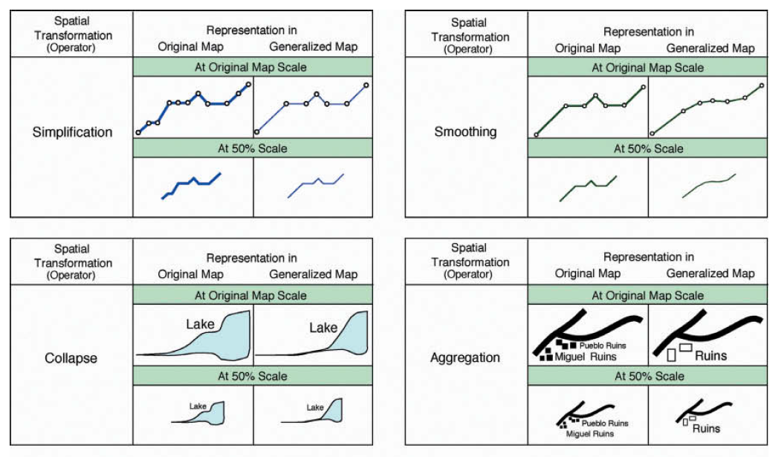
Illustrations from McMaster and Shea of their 10 forms of generalization

Slide 32
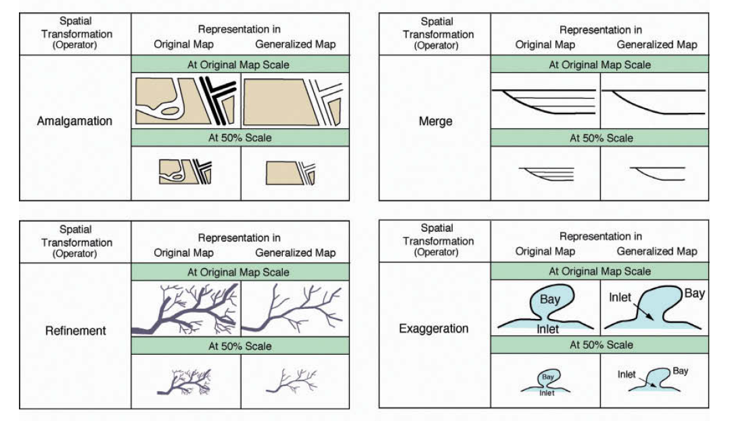
Illustrations from McMaster and Shea of their 10 forms of generalization

Slide 33
Illustrations from McMaster and Shea of their 10 forms of generalization

Slide 34
The Douglas–Peuker algorithm
is designed to simplify complex objects like this shoreline by reducing the number of points in its polyline representation.
(© iStockphoto)

Slide 35
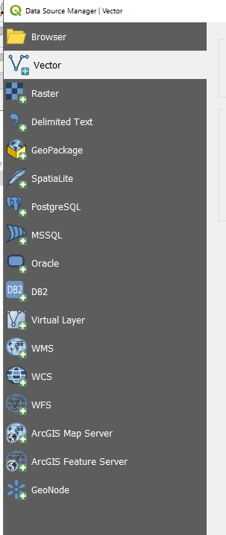
Geographic Data Storage Formats
You have seen:
Shape files
CSV
Many other file types
See QGIS:
Add vector:
File
Directory
Protocol
Database
Web Services

Slide 36
Summary: Key Decisions
Abstraction: which elements are important?
Representation: field or object?
Generalisation: how much detail?
Structure:
What type of geometry?
Which attributes?

