Slide 1
The Nature of Geographic Data

Slide 2
Overview
Elaborates on the spatial is special theme
Focuses on how phenomena vary across space and the general nature of geographic variation
Describes the main principles of:
Spatial variation - spatial autocorrelation
Scale
The concept of fractals.

Slide 3
What is Special about Spatial/Geographic Information (1)?
It is multidimensional (x, y, z)
Large volumes
It may be collected by many different groups, organisations, individuals and needs to be integrated
It may be represented at different resolutions
It must be projected onto a flat surface

Slide 4
What is Special about Spatial/Geographic Information (2)?
It may be represented in different data structure
It requires specific analysis methods
It requires a range of visualisation methods

Slide 5
Introduction
Understanding of the ways in which we think about the nature of spatial variation, and ascribe three principles to it:
that proximity effects are key to understanding spatial variation, and to joining up incomplete representations of unique places;
that issues of geographic scale and level of detail are key to building appropriate representations of the world;
that different measures of the world co-vary, and understanding the nature of co-variation can help us with prediction

Slide 6
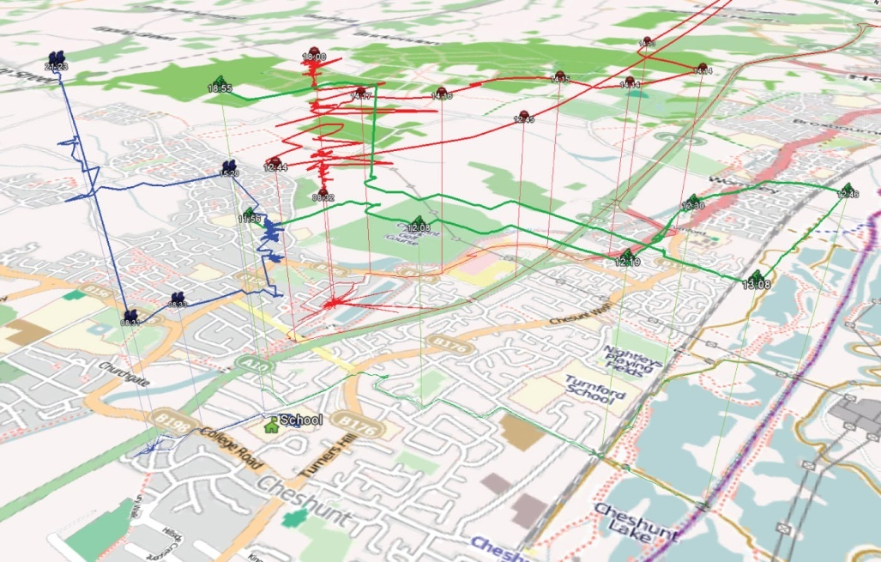
Your life…
A digital representation of your life is infinitesimally small compared with the geographic extent and history of the world

Slide 7
GI is About
Representing spatial and temporal phenomena in the real world
and, because the real world is complex, this task is difficult and error prone.
Thus,
Small things (e.g., lives!) are very intricate in detail
Viewed in aggregate human activity exhibits structure across geographic spaces

Slide 8
The Fundamental Problem
Must be competent in discarding (or not feeling troubled to measure) the inessentials while retaining the salient characteristics of the observable world
Distinguishes between controlled variation, which oscillates around a steady state, and uncontrolled variation
Some applications address controlled variation, such as utility management (daily and weekly patterns)
Others address uncontrolled, such as those studying longer term processes (e.g. climate change)

Slide 9
The Fundamental Problem
“Our behavior in space often reflects past patterns of behavior”
time is one-dimensional, need only look in the past, whereas spatial events can potentially have consequences anywhere in two-dimensional or even three-dimensional space.
How and why does spatial and temporal context affect what we do?
Home vs holiday
Week vs weekend

Slide 10
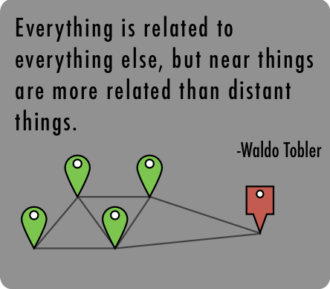
Waldo Tobler: First Law of Geography
"Everything is related to everything else,
but near things are more related than distant things.“
[Tobler, 1970, p.236]

Slide 11
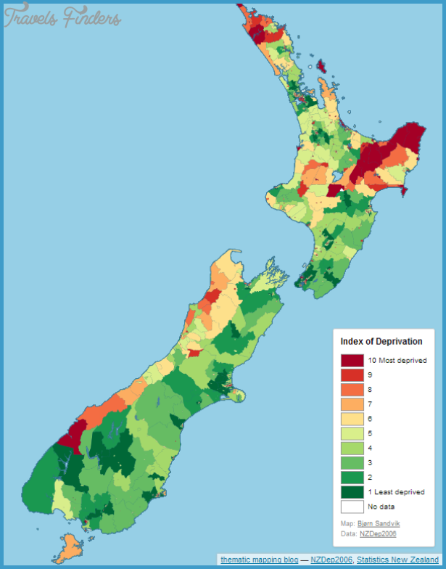

Slide 12
Spatial Autocorrelation
Systematic spatial variation in some phenomena.
Things that are spatially autocorrelated are not randomly distributed through space.
Positive spatial autocorrelation: things that are close together are more likely to be similar
Socio-economic group.
Vegetation type.
Climate.
Negative spatial autocorrelation: things that are close together are more likely to be different
Examples…?

Slide 13
Spatial Autocorrelation
Spatial autocorrelation is determined both by similarities in position, and by similarities in attributes
positive, zero, or negative
Lots of different indexes
Moran’s I
Geary’s C
Ripley’s K

Slide 14
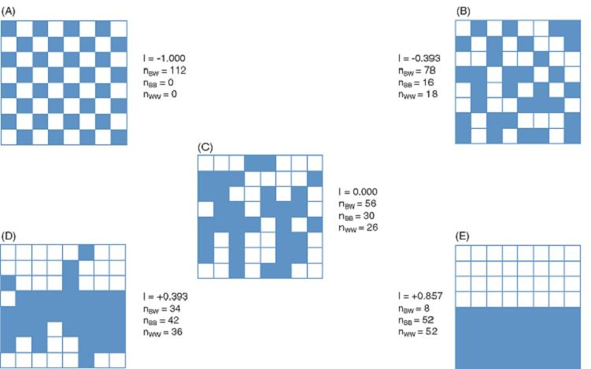
If features that are similar in location are also similar in attributes, then the pattern as a whole is said to exhibit positive spatial autocorrelation.
Nominal data: blue and white
Extreme negative
Extreme positive

Slide 15
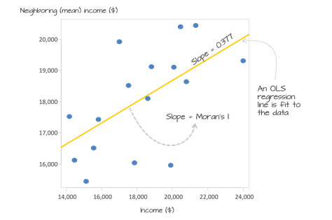
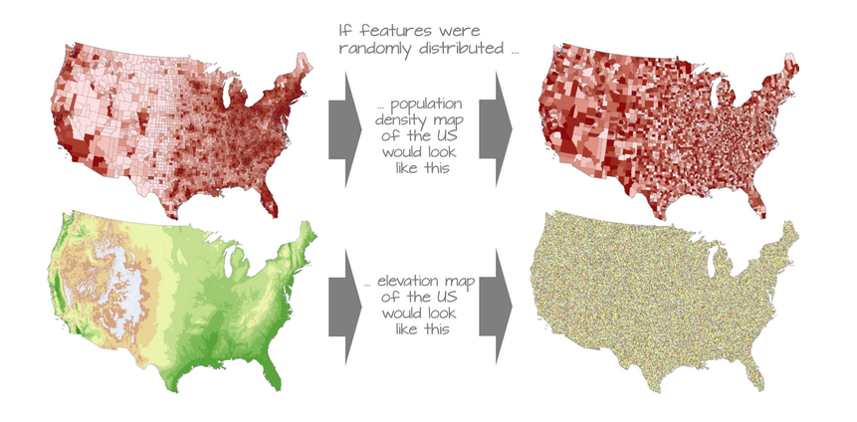
Useful Online Resource:
See a worked example calculation here:
https://mgimond.github.io/Spatial/spatial-autocorrelation.html

Slide 16
Spatial Autocorrelation – some issues to consider
Measurement scales and assessment of neighborhood
Issue of sampling intervals
rhythm of temporal activities and spatial patterning
Self-similarity of spatial and temporal structure
Extent that patterns are replicated across scales
Fine scale
Coarse scale

Slide 17
Spatial Autocorrelation and Scale
Understanding of spatial autocorrelation helps us to generalize from sample observations
becomes easier to build good generalized representations of spatial distributions
Spatial autocorrelation measures attempt to deal simultaneously with similarities in the location of spatial objects and their attributes
Measures of spatial and temporal autocorrelation are scale dependent

Slide 18
Spatial Autocorrelation and Scale
Understanding scale and spatial structure tell us:
how we should sample geographic reality
how we should interpolate between sample observations in order to build representations
Scale, sampling, and interpolation are key to geographic representation

Slide 19
So, how do we take spatial samples?
Sample frames (Area of interest)
Sampling selects points from a continuous field or, in object case, selects some of these objects while discarding others
Scientific sampling requires that each element in the sample frame has a known and prespecified chance of selection

Slide 20
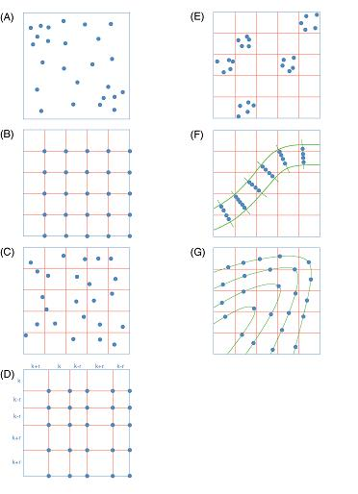
Random Sample
Clustered Sampling
Sampling along
Transect
Stratified Sample
Stratified
Random Sample
Contour Sampling
Stratified
Sample with random
variation in grid squares
Spatial sample designs

Slide 21
Area of Leicestershire
Hilly Terrain
Flat, flood plain
Thus, may be sensible to partition sample frame into sub-areas, based on known spatial structure
Application-specific sampling to obtain spot heights – may make more observations in hilly terrain where local variation likely to be more heterogeneous

Slide 22
Random Sample
Clustered Sampling
Sampling along
Transect
Stratified Sample
Stratified
Random Sample
Contour Sampling
Stratified
Sample with random
variation in grid squares
Which design would you use for:
Bird sightings
Mineral samples
Voting preferences
Health profiles
Retail distribution

Slide 23
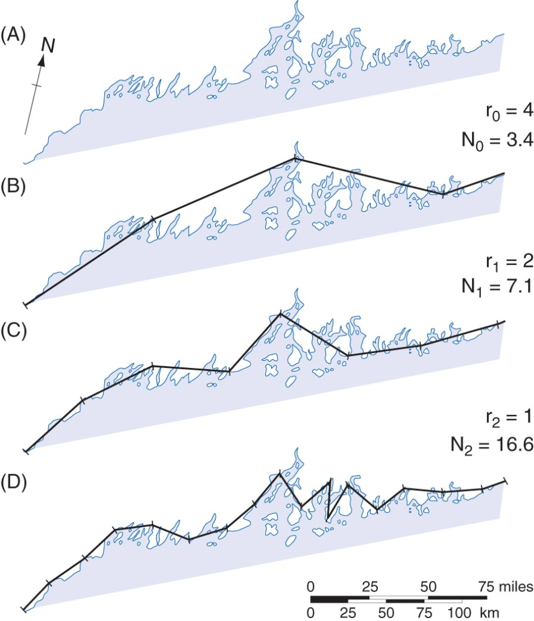
Another Kind of Sampling
The coastline of Maine, at three levels of recursion
the base curve of the coastline
(B) approximation using 100-km
steps
(C) 50-km step approximation; and
(D) 25-km step approximation.
Different levels are often used at different scales

Slide 24
Sampling and VGI
More data are collected by other parties rather than for particular purpose
with the increasing dominance by Big and Open Data
Bias is consequently almost inevitable, and the source and effects of such bias may not be obvious.
Sampling theory tells us that seeking to accommodate the effect of bias is a very dangerous practice.
Volunteered geographic information (VGI)
It may be possible to invoke automated procedures that are robust and open to scrutiny to ensure that the data provided are unbiased.
E.g. Impact on OpenStreetMap?

Slide 25
Spatial Interpolation
How to fill in the gaps between our observations?
What is likely attenuating effect of distance between the sample observations?
Identify an appropriate interpolation function

Slide 26
Distance Decay
linear distance decay
(B) negative power distance decay
(C) negative exponential distance decay

Slide 27
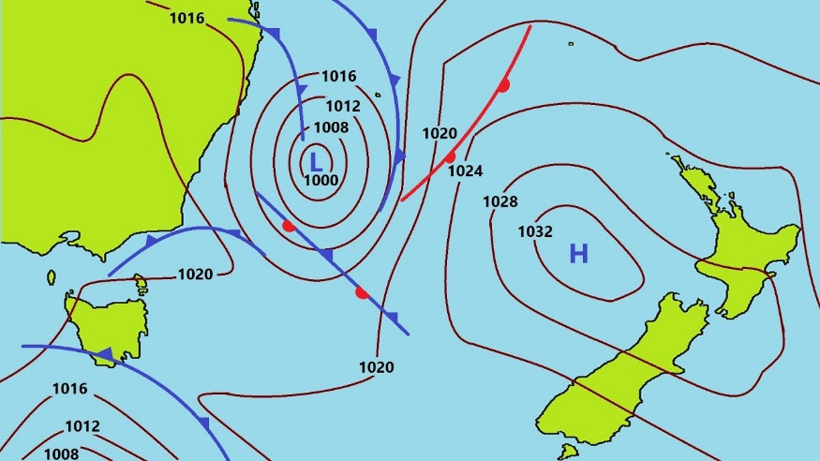
The Creation of Isopleth Maps
Each graph is regular, continuous, and isotropic
Smooth and continuous variation
As in isopleth charts
Isoline – connect equal values
Iso = equal, similar (Greek)
isobar
isohyet
contour

Slide 28
Example
https://www.topomap.co.nz/

Slide 29
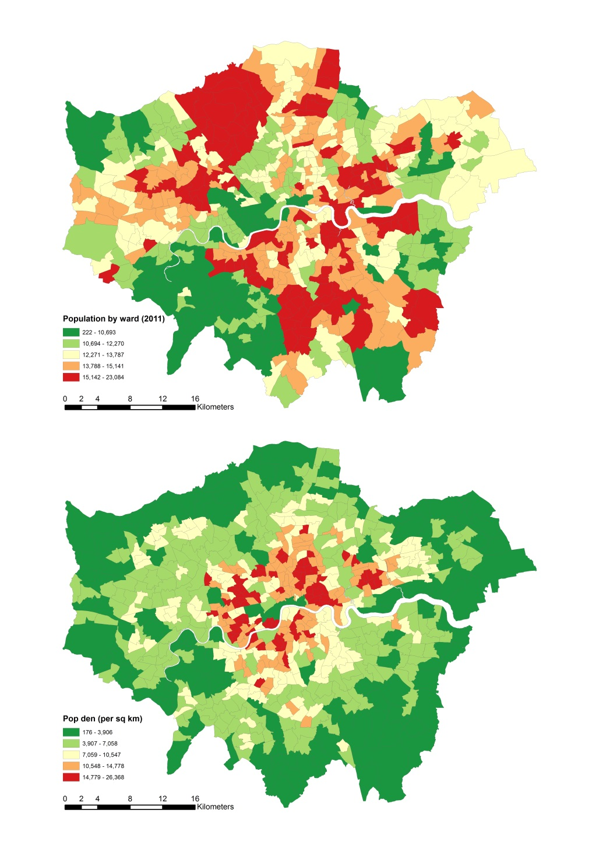
Choropleth Maps
a spatially extensive variable, total population.
Spatially extensive variables are true of the area as a whole.
(B) a related but spatially intensive variable, population density.
Spatially intensive areas are normalized (densities, ratios, percentages).
Many cartographers would argue that (A) is misleading and that spatially extensive variables should always be converted to spatially intensive form before being displayed as choropleth maps.

Slide 30
Conclusions
Tobler’s first law of geography
Spatial autocorrelation
Can be measured by Moran’s I, etc.
Scale & level of geographic detail in a representation
Sampling
Spatial variation can be smooth and continuous, but also can be jagged and irregular

